Slide 1
Sistem Digital Pertemuan 1
Vittalis Ayu

Slide 2
Analog vs Digital
Contoh representasi analog?
Contoh representasi digital?
Tombol on/off
Kode Morse
Spedometer
Termometer

Slide 3
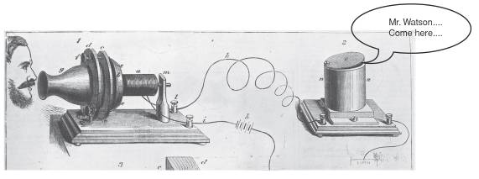
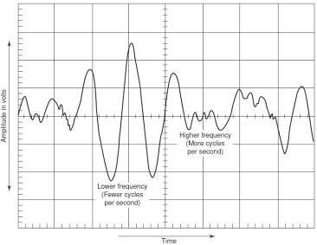
Analog
Direpresentasikan dengan continously variable indicator.
Infinite possibilites
Today, the device that converts sound energy to an analog voltage signal is known as a microphone.

Slide 4
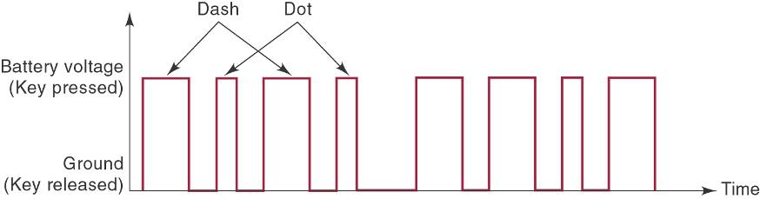
Digital
Direpresentasikan dengan digit (step by step /diskrit)
Merepresentasikan informasi dalam 2 state : 1 atau 0

Slide 5
Analog atau digital?
Jumlah pasir dalam suatu ember
Jumlah batu dalam suatu ember
Jumlah air dalam suatu ember

Slide 6
Sistem digital
A digital system is a combination of devices designed to manipulate logical information or physical quantities that are represented in digital form; that is, the quantities can take on only discrete values.
Bagaimana merepresentasikan 0 dan 1 secara elektronik pada suatu sistem digital?
..............................................

Slide 7
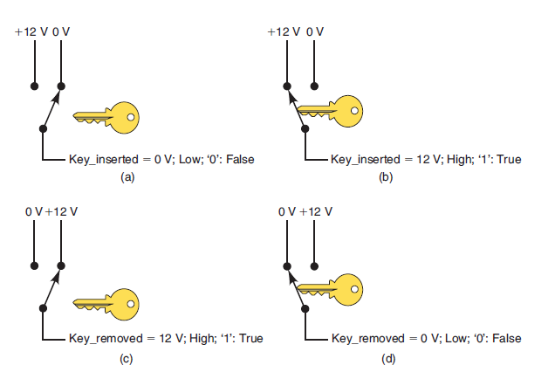

Slide 8
Sistem Analog
An analog system contains devices that manipulate physical quantities that are represented in analog form. In an analog system, the quantities can vary over a continuous range of values

Slide 9
Keuntungan menggunakan sistem digital
Mudah dirancang
Penyimpanan informasi lebih mudah
Akurasi sistem dapat didefinisikan dengan lebih mudah.
Operasi operasi dalam sistem digital dapat “di-program”
Lebih tahan terhadap noise
Complex digital circuit dapat di- fabrikasi ke dalam IC.

Slide 10
Kekurangan dari sistem digital
The real world is analog.
Processing digitized signals takes time.

Slide 11
Konversi
ADC : Analog to Digital Converter
DAC : Digital to Analog Converter

Slide 12
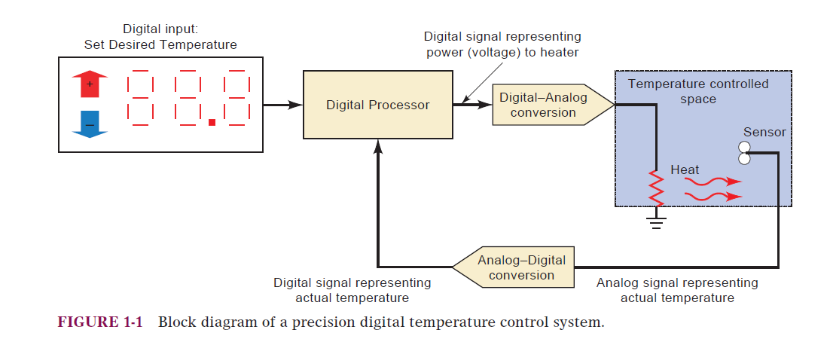
Contoh :

Slide 13
The Future is Digital

Slide 14
Sistem bilangan dalam teknologi digital
Sistem bilangan desimal
Sistem bilangan biner

Slide 15
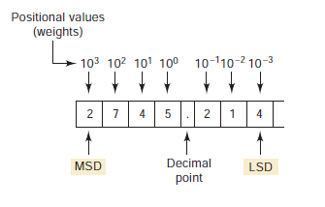
Sistem bilangan desimal
Bilangan berbasis 10
MSD : Most Significant Digit
LSD : Least Significat Digit

Slide 16
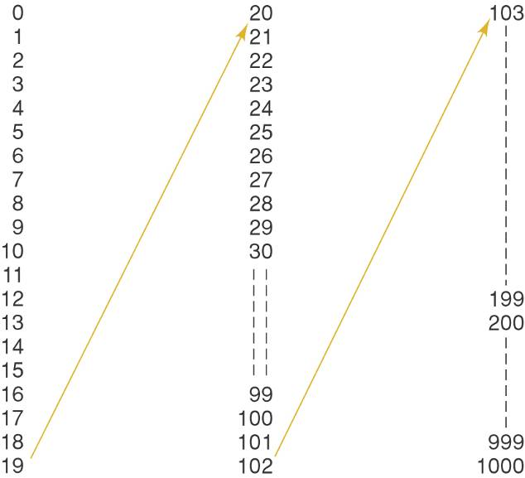

Slide 17
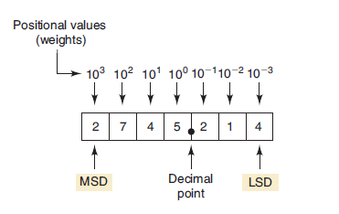


Slide 18
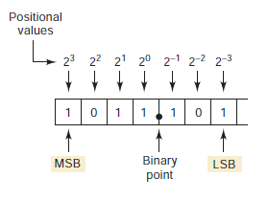
Sistem bilangan biner
Bilangan Berbasis dua
MSB : Most Significant Bit
LSB : Least Significant Bit

Slide 19
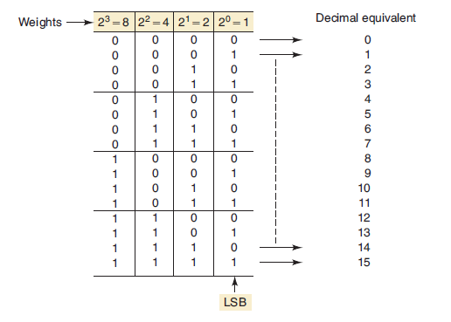

Slide 20
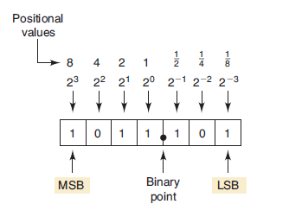
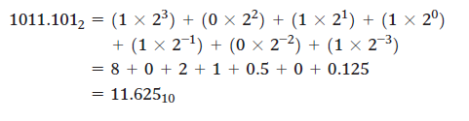

Slide 21
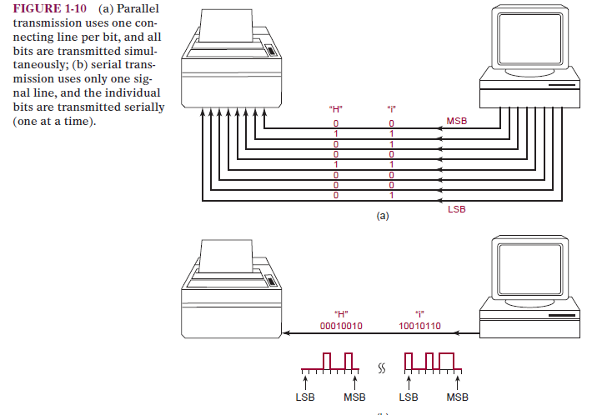
PARALLEL VS SERIAL

Slide 22
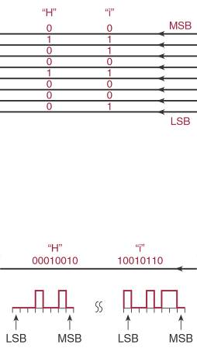
Parallel transmission is faster but requires more paths.
Serial is slower but requires a single path.

Slide 23
Reference
Tocci, Ronald J., Widmer, Neal S., Moss, Gregory L. 2007. Digital Systems Principles and Applications. 12th edition, Prentice Hall. New Jersey.

